Slide 1


Introduction to Artificial Intelligence
Lyernisha S R
Lecturer, FICT

Slide 2
Content
Introduction to AI
AI definitions
Types of AI
Turing test
Chinese room argument
Symbolic AI vs. Computational Intelligence

Slide 3
Artificial Intelligence
Intelligence is the ability to learn and understand, to solve problems and to make decisions.
A machine is thought intelligent if it can achieve human-level performance in some cognitive task. To build an intelligent machine, we must capture, organize and use human expert knowledge in some problem area.

Slide 4
AI- Definitions
Artificial intelligence (AI) is a wide-ranging branch of computer science concerned with building smart machines capable of performing tasks that typically require human intelligence.
Artificial intelligence is a science that has defined its goal as making machines do things that would require intelligence if done by humans.
Artificial intelligence is the simulation of human intelligence processes by machines, especially computer systems. Specific applications of AI include expert systems, natural language processing, speech recognition and machine vision.

Slide 5
AI-Types
Based on Functionality
Based on Ability/Technology
Reactive Machines
Limited Memory
Theory of Mind
Self-Awareness
Weak AI
Strong AI
General AI
Super AI

Slide 6
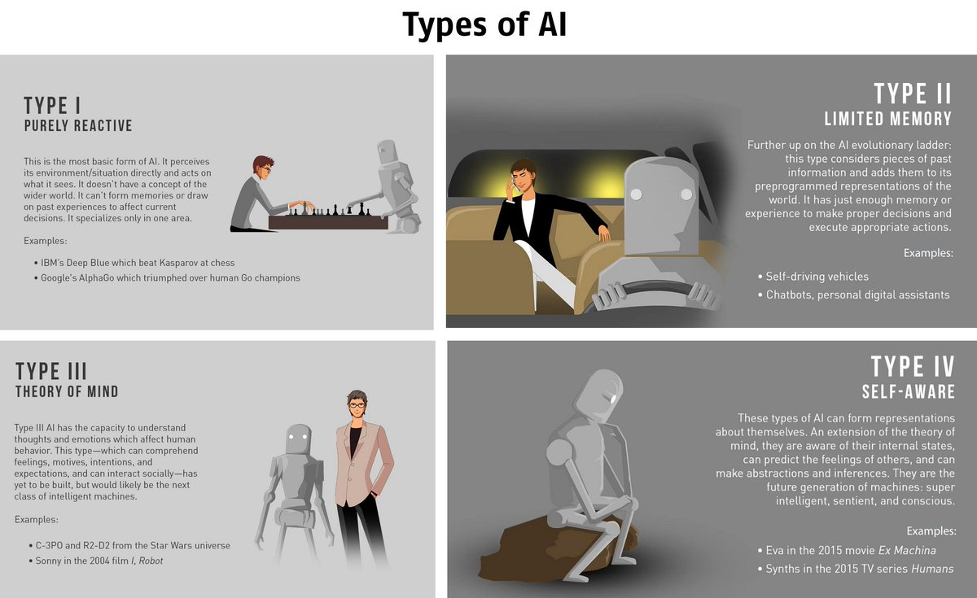
Types of AI based on Functionality

Slide 7
Types of AI based on Ability
Weak AI
Also known as narrow AI, focuses on performing a specific task, such as answering questions based on user input or playing chess.
It can perform one type of task, but not both
Examples of weak AI include Siri, Alexa and Google search
Strong AI
Strong AI can perform a variety of functions, eventually teaching itself to solve for new problems.
It can solve any unfamiliar task on its own
In theory, a strong AI program should be able to pass both a Turing Test and the Chinese room test.

Slide 8
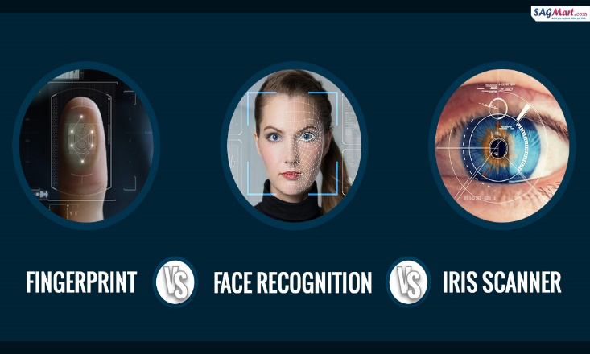
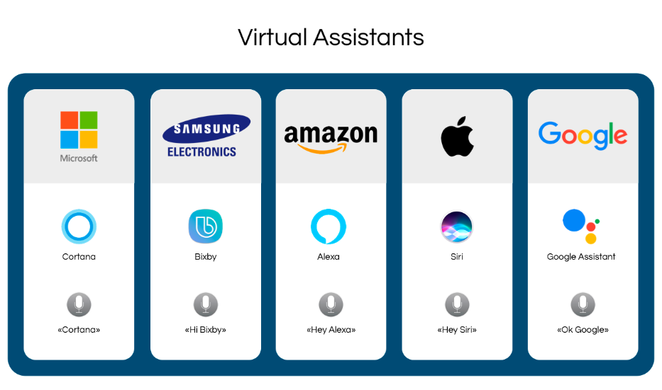
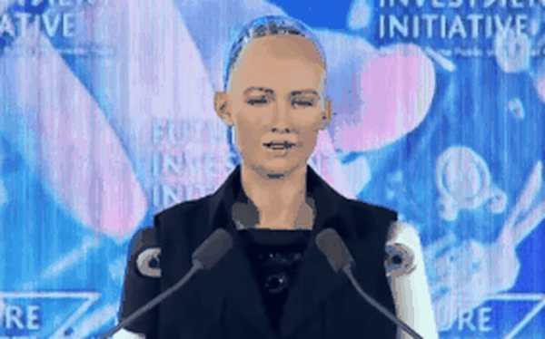
Weak AI examples

Slide 9



Strong AI - Examples

Slide 10

Turing test
The Turing test, originally called the imitation game by Alan Turing in 1950
It is a test of a machine's ability to exhibit intelligent behavior equivalent to, or indistinguishable from, that of a human.

Slide 11
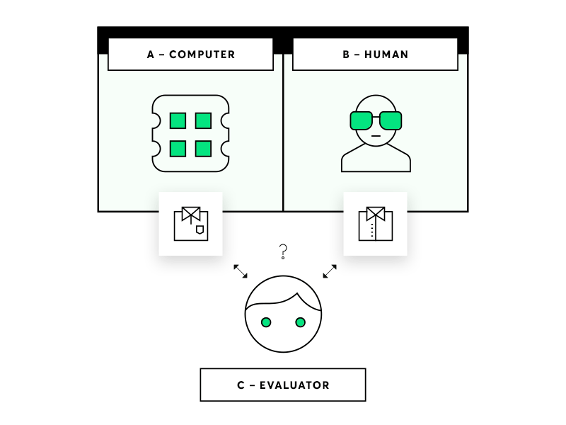
Turing test – cont.…
During the test, one of the humans' functions as the Evaluator, while the second human and the computer function as Respondents.
The Evaluator interrogates the respondents within a specific subject area, using a specified format and context.
After a preset length of time or number of questions, the Evaluator is then asked to decide which respondent was human and which was a computer.

Slide 12
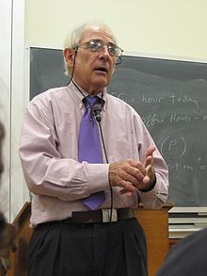
Chinese room argument
John Rogers Searle (born July 31, 1932) is an American philosopher.
The Chinese room argument holds that a digital computer executing a program cannot have a "mind", "understanding" or "consciousness", regardless of how intelligently or human-like the program may make the computer behave.

Slide 13
Chinese room argument – Cont..
Imagine a native English speaker who knows no Chinese is locked in a room full of boxes of Chinese symbols (a data base) together with a book of instructions in English for manipulating the symbols (the program).
Imagine that people outside the room send in other Chinese symbols which, unknown to the person in the room, are questions in Chinese (the input).
And imagine that by following the instructions in the program the man in the room can pass out Chinese symbols which are correct answers to the questions (the output).
The program enables the person in the room to pass the Turing Test for understanding Chinese, but he does not understand a word of Chinese.

Slide 14
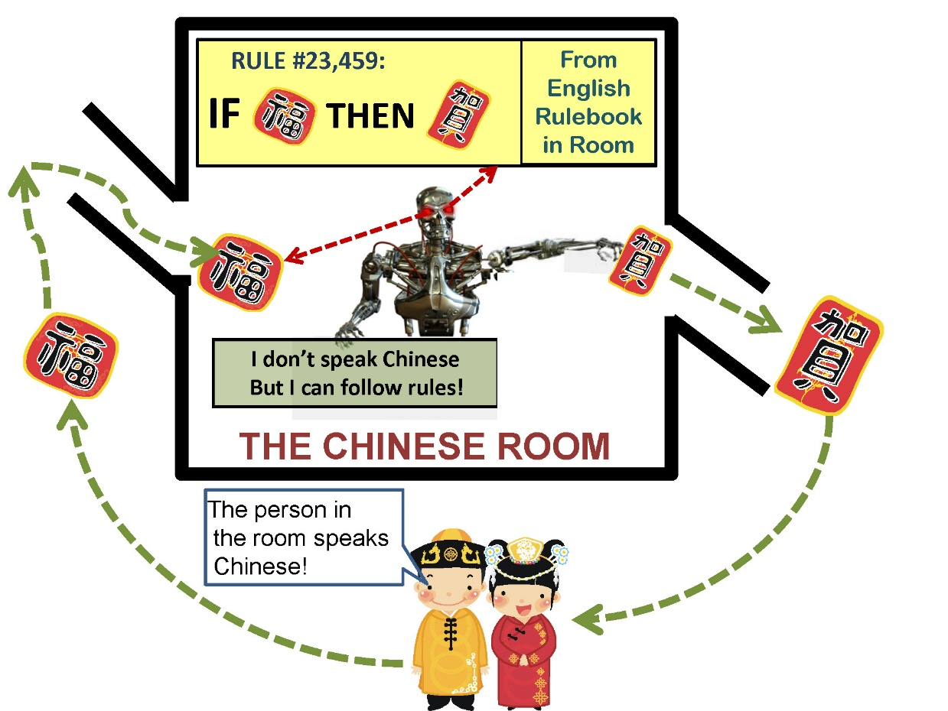
Chinese room argument – Cont..

Slide 15
Chinese room argument – Cont..
The question Searle wants to answer is this:
Does the machine literally "understand" Chinese? Or
Is it merely simulating the ability to understand Chinese?
Searle calls the first position "strong AI" and the latter "weak AI".

Slide 16
Symbolic Processing vs. Computational Intelligence.

Slide 17
Symbolic Processing
Symbolic artificial intelligence is based on high-level symbolic (human-readable) representations of problems, logic and search
Symbolic AI used tools such as logic programming, production rules, semantic nets and frames.
Symbolic AI, also known as Good, Old-Fashioned AI (GOFAI),

Slide 18
Symbolic Processing – Cont…
The most successful form of symbolic AI is Expert Systems [ES], which use a network of production rules.
Production rules connect symbols in a relationship like an If-Then statement.

Slide 19
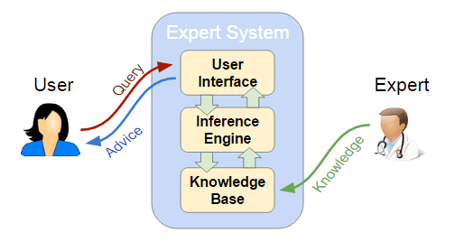
Symbolic Processing – Cont…

Slide 20
Computational Intelligence
Computational intelligence (CI) usually refers to the ability of a computer to learn a specific task from data or experimental observation.
CI is a set of nature-inspired computational methodologies and approaches to address complex real-world problems to which mathematical or traditional modelling can be useless
Traditionally the three main pillars of CI have been Neural Networks, Fuzzy Systems and Evolutionary Computation.

Slide 21
Computational Intelligence – Cont…
CI therefore uses a combination of five main complementary techniques :
The Fuzzy Logic: Enables the computer to understand natural language.
Artificial Neural Networks (ANN) : Permits the system to learn experiential data by operating like the biological one
Evolutionary Computing : Based on the process of natural selection (swarm intelligence)
Learning theory : Helps understanding how external effects and experiences are processed, and then helps making predictions based on previous experience.
Probabilistic methods : Probabilistic methods bring out the possible solutions to a reasoning problem, based on prior knowledge

Slide 22
Thank you

